Slide 1


Hope to Skills
Lecture# 28
Irfan Malik, Dr. Sheraz Naseer

Slide 2
Agenda
Chat Bots
Openai
Streamlit
Langchain

Slide 3
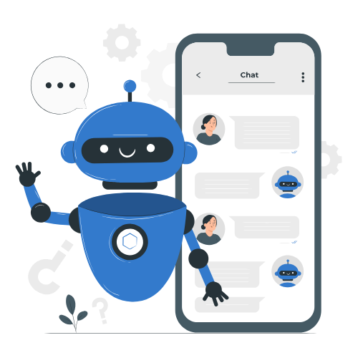
Chat bot
Computer programs designed to simulate human conversation.
Used for various purposes: customer support, information retrieval, and more.

Slide 4
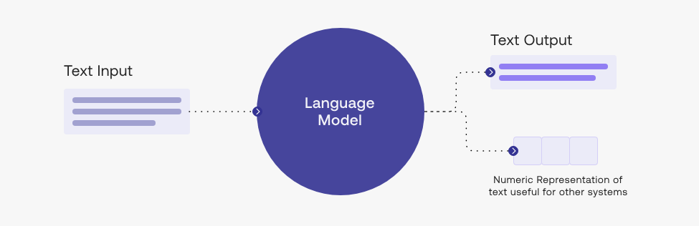
What are Large Language Model (LLM)?
LLMs like GPT-3 and GPT-4 are powerful AI models for natural language understanding and generation.
They can understand and generate human-like text.

Slide 5

Overview of Streamlit
Streamlit is an open-source Python library for creating web applications with minimal effort.
Key Features:
Easy-to-use
Real-time updates
Integration with Python data libraries

Slide 6
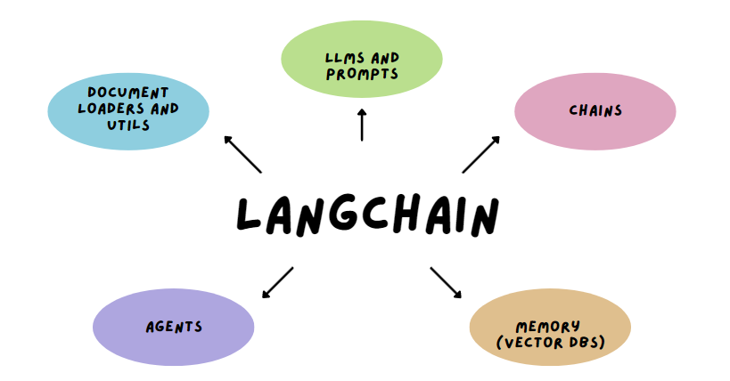
Introducing Langchain
Langchain is a tool for building chatbots.
It contains agents and chains to process text data.
Helps streamline chatbot development.

Slide 7
User Input

Slide 8
Chat bot Hands on

